Slide 1
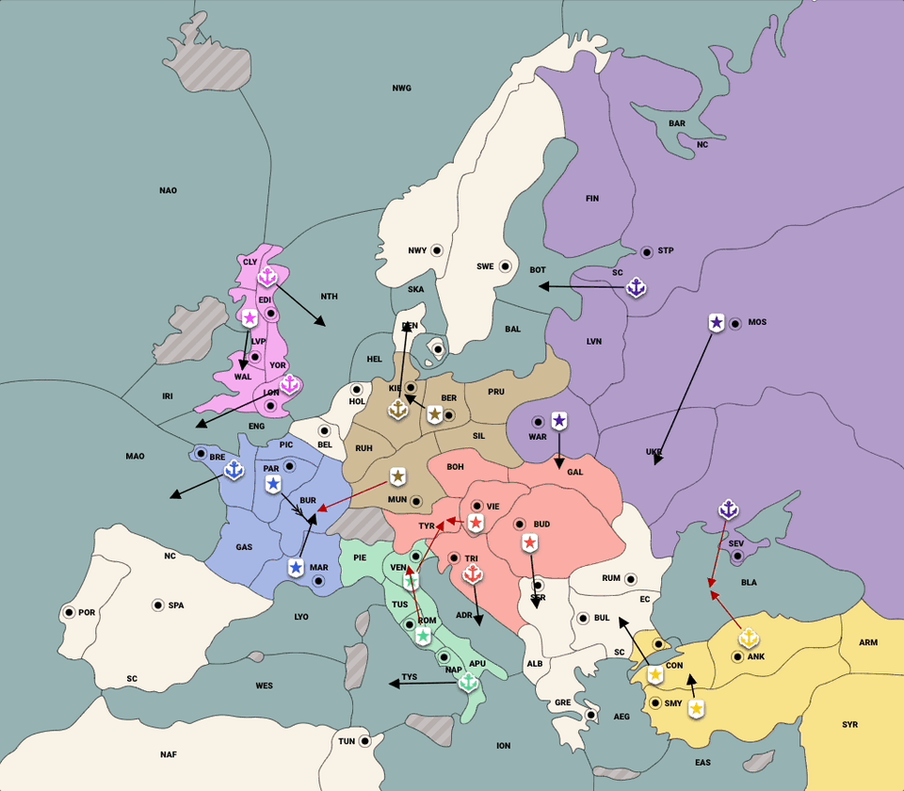
Learning to Cooperate and Compete via Self Play
Noam Brown
Notes:
Cicero is the name of the agent we built for Diplomacy. It integrates high-level strategic play with full open-domain dialogue. It’s interesting to note that DeepMind wrote a Nature comment last year proposing simplified versions of Diplomacy as challenge problems because full dialogue seemed intractable.
And a big part of why we were able to go to full dialogue is that we initated a partnership with webdiplomacy, an online Diplomacy site, where we got access to anonymized dialogue from 50,000 human games

Slide 2
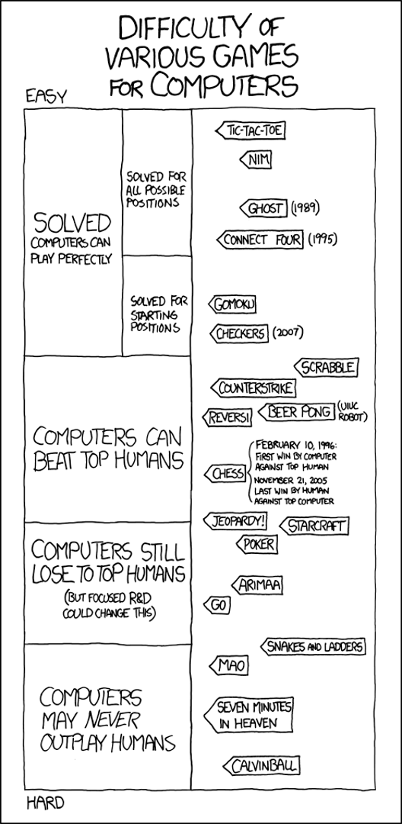
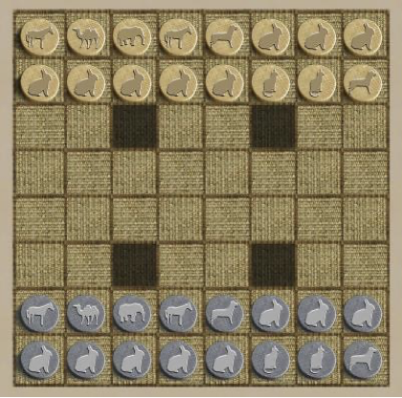
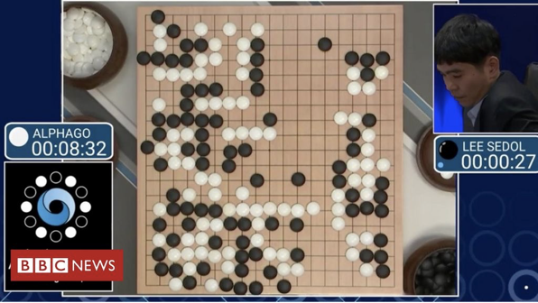

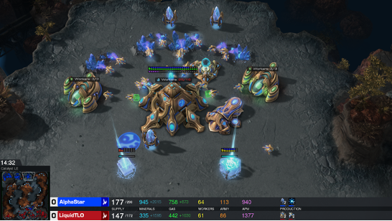
2019
2017/2019
2015
2016

Slide 3
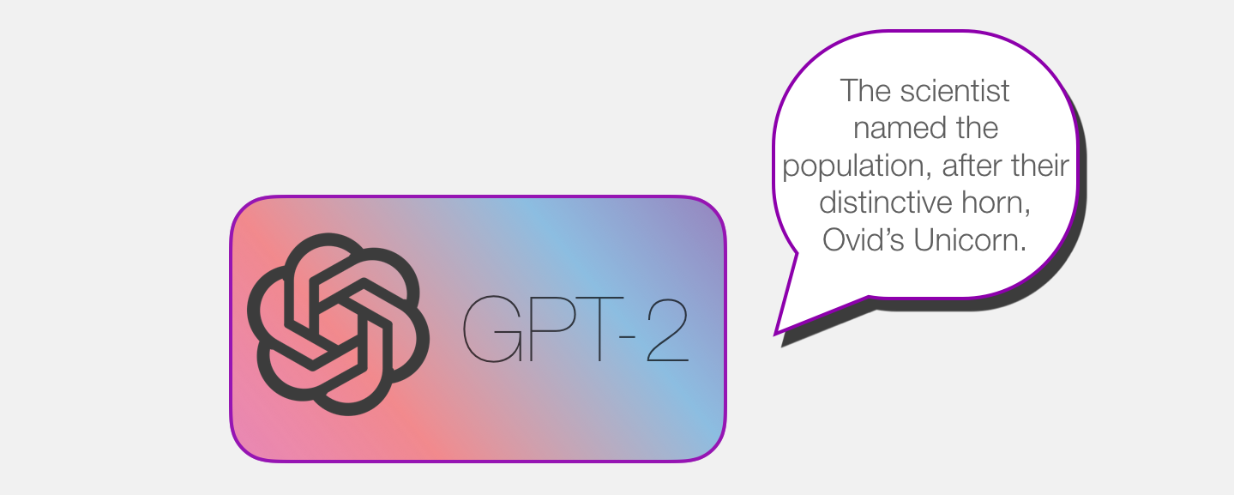

Slide 4
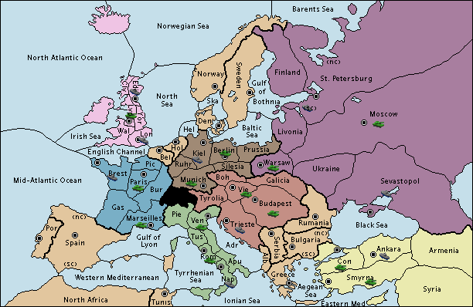
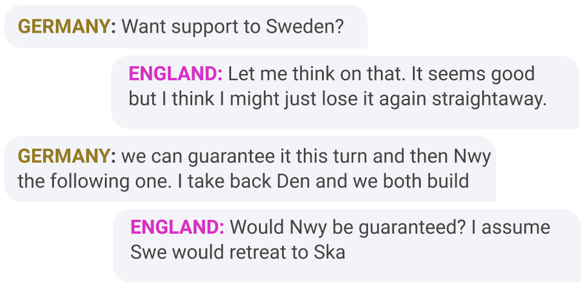
a popular board game from the 50's and was JFK's and Kissinger's favorite game
A popular strategy game from the 50s
7 players trying to conquer Europe in WW1
JFK and Kissinger’s favorite game
Each turn involves private natural language negotiation
Moves are done simultaneously
e.g. F CLY - NWG, A DEN H, F SKA – NWY, …
Alliances and trust-building are key!
Long considered a challenge problem for AI [1]
Research going back to the 80’s
Research picked up in 2019 with work from MILA, DeepMind, ourselves, others
[1] Dafoe et al. “Cooperative AI: machines must learn to find common ground”.
Nature comment, 5/2021
Notes:
On each turn, the players have private conversations with each other where they form alliances, negotiate how they’ll work together, and coordinate what actions they’re going to take.
At the end of the turn, every player secretly enters their moves and they’re revealed simultaneously. These moves consist of orders for each of a player’s units on the board, for example Fleet Clyde moves to Norwegian Sea, Army Denmark Holds, Fleet Skaggerak supports Army Sweden to Norway, and so on. So the actions are part of an exponentially large action space. And the private agreements between players are non-binding, so players need to build trust and have to account for the fact that other players may be lying or might not follow through on their agreements.
Ultimately, winning at Diplomacy requires players to be able to persuade and cooperate with others
And it’s long been considered a challenge problem for AI.

Slide 5
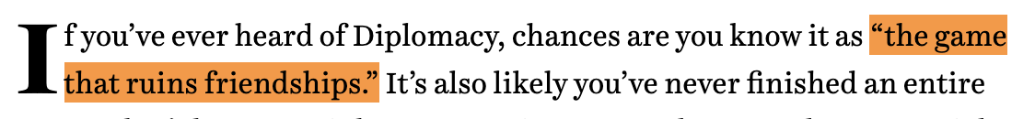



Slide 6
“Diplomacy is ultimately about building trust in an environment that encourages you to not trust anyone.”
-Andrew Goff 3-Time Diplomacy World Champion

Slide 7
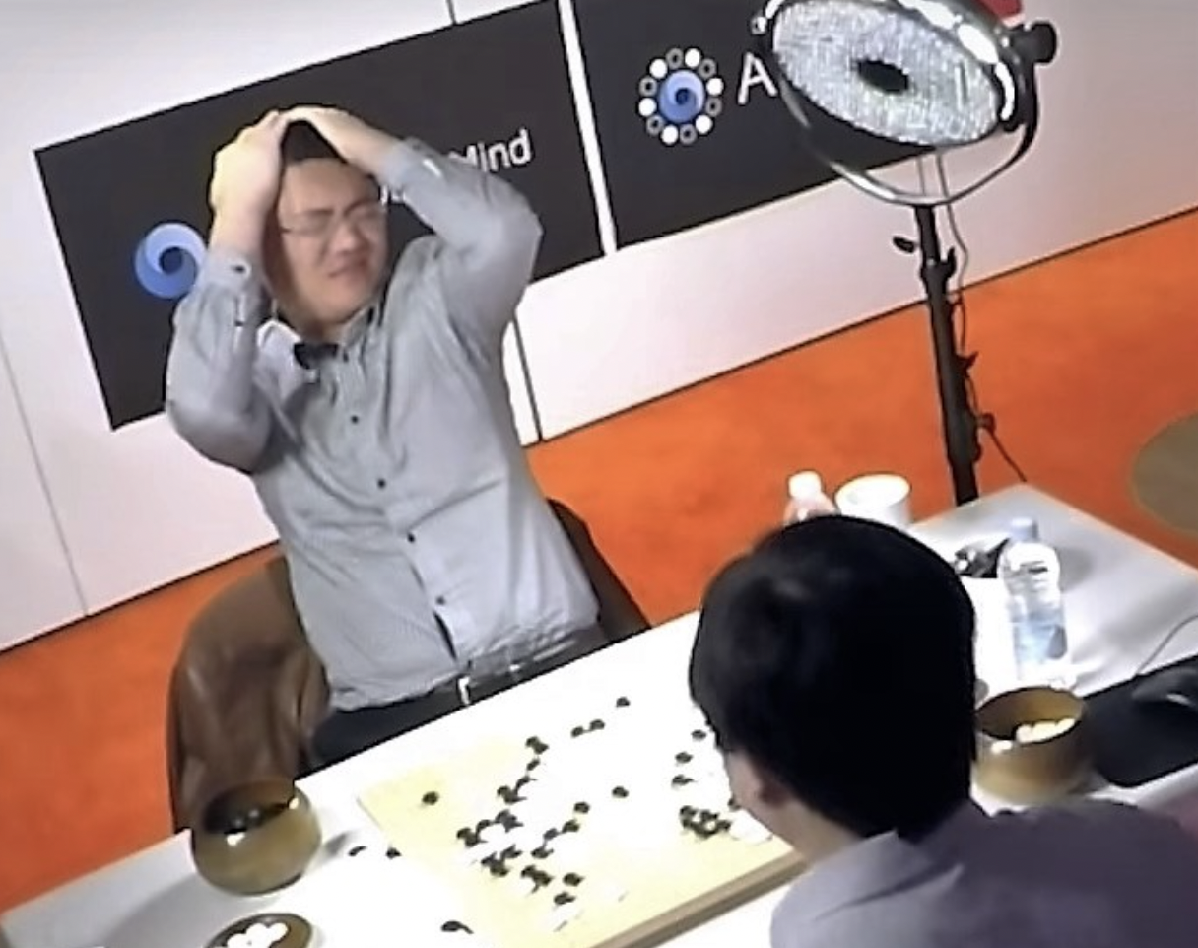

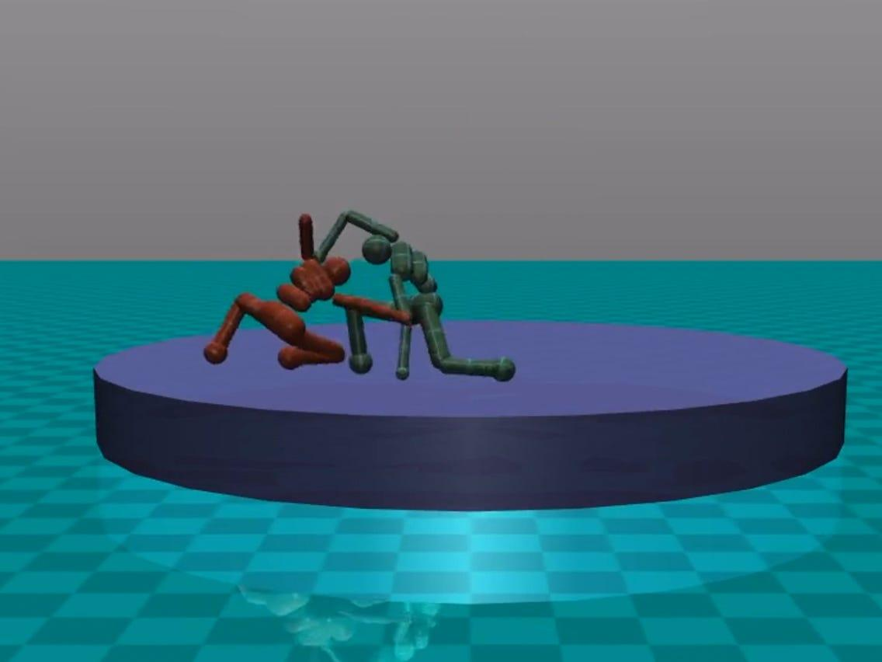
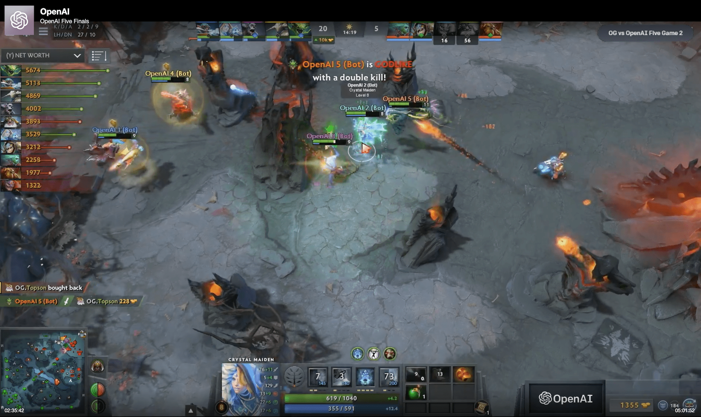
Self-Play in 2p 0-Sum Games

Slide 8

Who is the better poker player?
Option 1: Someone who, over a large enough sample size, wins head-to-head vs. any other player
Option 2: Someone who makes more money playing poker than anyone else

Slide 9
Who is the better poker player?
Option 1: Someone who, over a large enough sample size, wins head-to-head vs. any other player
Option 2: Someone who makes more money playing poker than anyone else
Minimax Equilibrium
Population Best Response

Slide 10


Minimax Equilibrium
Minimax Equilibrium in 2p0sum: each player’s strategy is optimal given the other player’s policy
In balanced games, playing minimax ensures you will not lose on average
Exploitability: How much we’d lose to a best response
 | Round 1 | Round 2 | Round 3
Us
Best Response
Our Exploitability = 1

Slide 11
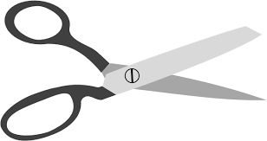
Minimax Equilibrium
Minimax Equilibrium in 2p0sum: each player’s strategy is optimal given the other player’s policy
In balanced games, playing minimax ensures you will not lose on average
Exploitability: How much we’d lose to a best response
 | Round 1 | Round 2 | Round 3
Us
Best Response
Our Exploitability = 1

Slide 12

Minimax Equilibrium
Minimax Equilibrium in 2p0sum: each player’s strategy is optimal given the other player’s policy
In balanced games, playing minimax ensures you will not lose on average
Exploitability: How much we’d lose to a best response
 | Round 1 | Round 2 | Round 3
Us
Best Response
Our Exploitability = 0

Slide 13
Minimax Equilibrium
“Poker is simple, as your opponents make mistakes, you profit.”
-Ryan Fee’s Poker Strategy Guide
 | Round 1 | Round 2 | Round 3
Us
Best Response
Our Exploitability = 0

Slide 14
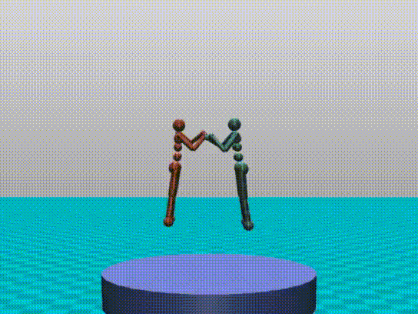

Self-play in two-player zero-sum games
In self-play, an agent gradually improves by playing against copies of itself
Initial strategy can be completely random
In balanced two-player zero-sum games, sound self-play provably converges to a minimax equilibrium
Thus, given sufficient memory and compute, any finite two-player zero-sum game can be “solved” via self-play
Notes:
The other perspective is a multi-agent perspective. If we think about all the big successes in AI agents in the past few years, they’ve all been in purely competitive games like chess, Go, and poker. And the reason for that is that in these settings self-play techniques are guaranteed to converge to an optimal solution with sufficient compute and model capacity. And that's how you end up with Kasparov or Fan Hui with their heads in their hands.
But the real world isn’t just about moving pieces on a chess board. It involves a mix of competition and cooperation with other people. In these settings, the self-play guarantees no longer apply, and success requires understanding human behavior and conventions.
And language is really the ultimate human convention, it’s what’s allowed humans to cooperate at such a large scale. This project is the first time that anyone has tackled a game where cooperation through language plays a central role.

Slide 15
Self-play in two-player zero-sum games
In self-play, an agent gradually improves by playing against copies of itself
Initial strategy can be completely random
In balanced two-player zero-sum games, sound self-play provably converges to a minimax equilibrium
Thus, given sufficient memory and compute, any finite two-player zero-sum game can be “solved” via self-play
Notes:
The other perspective is a multi-agent perspective. If we think about all the big successes in AI agents in the past few years, they’ve all been in purely competitive games like chess, Go, and poker. And the reason for that is that in these settings self-play techniques are guaranteed to converge to an optimal solution with sufficient compute and model capacity. And that's how you end up with Kasparov or Fan Hui with their heads in their hands.
But the real world isn’t just about moving pieces on a chess board. It involves a mix of competition and cooperation with other people. In these settings, the self-play guarantees no longer apply, and success requires understanding human behavior and conventions.
And language is really the ultimate human convention, it’s what’s allowed humans to cooperate at such a large scale. This project is the first time that anyone has tackled a game where cooperation through language plays a central role.

Slide 16
Question: Why is self play limited to two-player zero-sum games?
Answer: Because outside two-player zero-sum games, unlimited memory and compute isn’t enough. You may need human data as well!

Slide 17
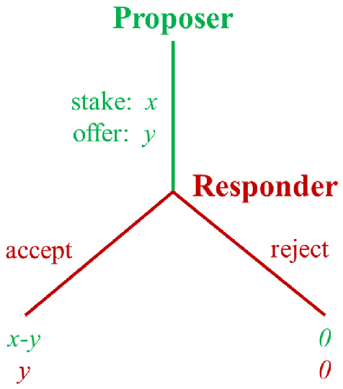
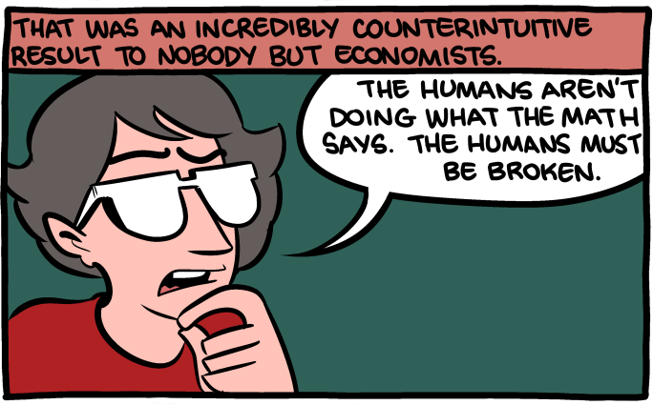
Ultimatum Game
Alice is given $100
Alice must offer $0 - $100 to Bob
Then, Bob must decide whether to accept or reject
If Bob accepts, then Alice and Bob keep their money
If Bob rejects, then Alice and Bob get nothing

Slide 18
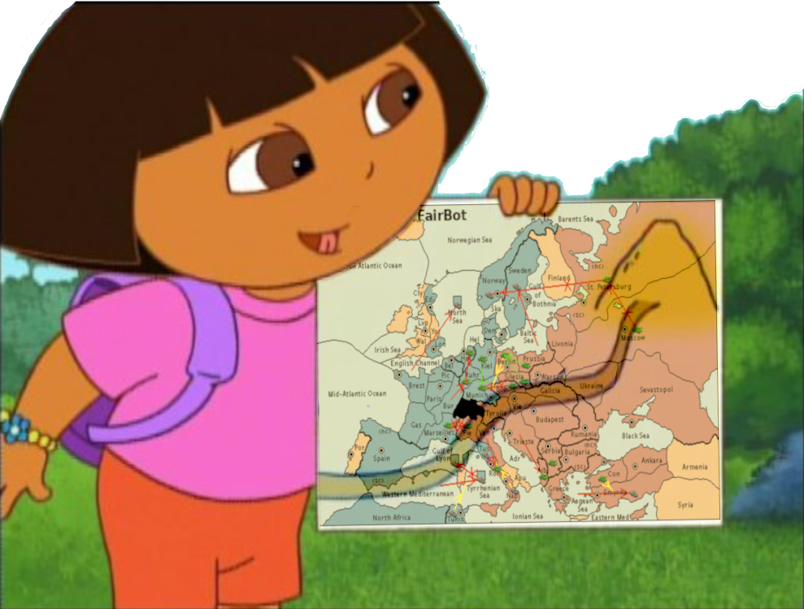
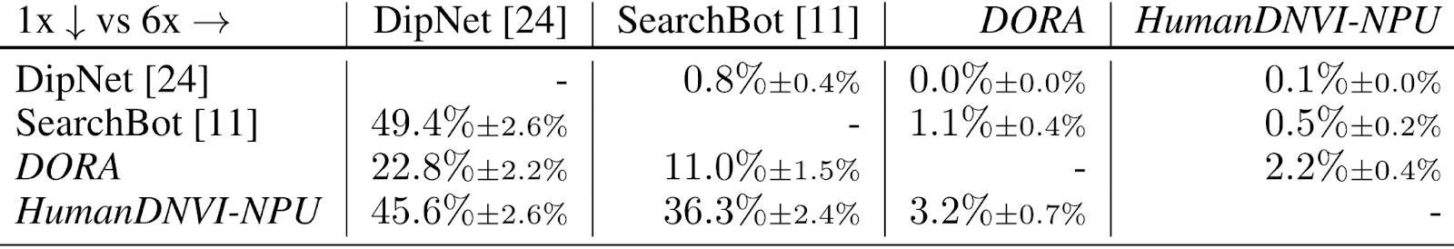
DORA: No-press Diplomacy from Scratch [1]
DORA learns no-press Diplomacy through self-play
Similar to AlphaZero
Performance with humans in 2-player no-press Diplomacy:
Win rate: 86.5% +- 6.1% vs human experts
Performance with bots in 7-player no-press Diplomacy:
[1] [Bakhtin, Wu, Lerer, Brown. NeurIPS 2021]

Slide 19

piKL- Human-regularized RL and planning
(Jacob et al. 2022)
Idea: Given anchor policy τ from human imitation learning, when optimizing policy π, optimize the regularized utility:
λ is the anchor strength:
λ = 0: self-play from scratch
λ = infinity: human behavioral cloning
Choosing λ in-between gains benefits of both.
Results: Significant policy improvement while maintaining high human compatibility.
Notes:
The second line of research we build on is that of pikl, from 2022, which is a simple way of adapting planning methods to stay close to human play. In pikl, the idea is simply to alter the definition of utility or reward being maximized to also include a penalty term that penalizes a policy from having high KL divergence with human behavioral cloning. The penalty is controlled by a lambda coefficient, where lambda 0 is unregularized planning, and lambda infinity is pure human behavioral cloning. Prior work shows that values of lambda in between can achieve the benefits of both, giving strong and human-like play.

Slide 20
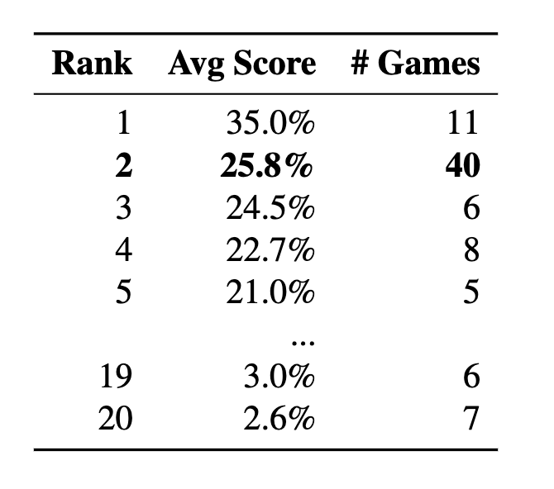
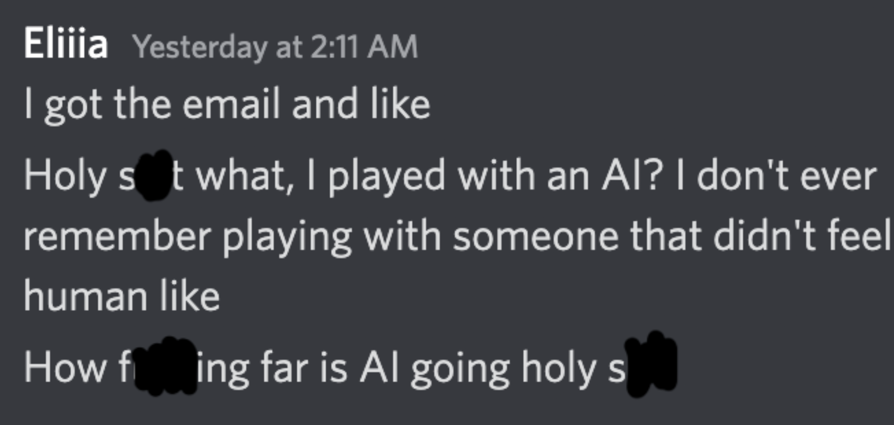
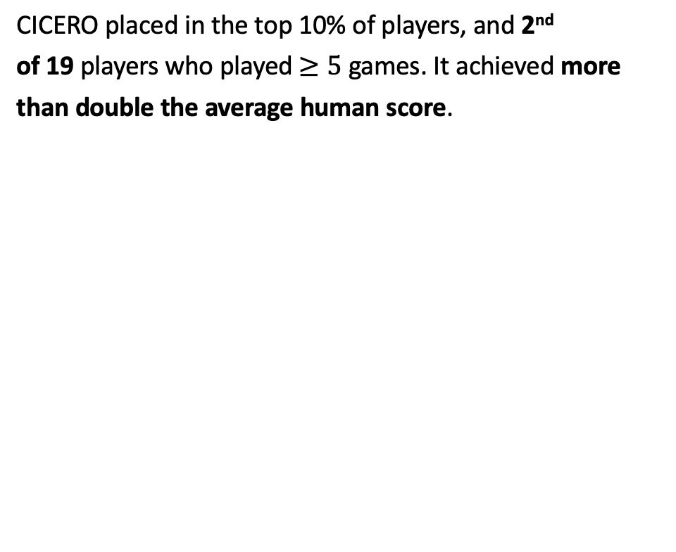
CICERO Plays with Humans
We entered CICERO anonymously in an online Diplomacy league
CICERO was not detected as an AI agent after
40 games with 82 unique players *, sending and receiving an average of 292 messages per game.
* One player mentioned in post-game Discord that they were suspicious that our account was a bot after a game, but didn’t follow up about it
Notes:
This summer we entered Cicero anonymously in an online Diplomacy league. We spent a lot of time preparing for this and frankly, it was pretty terrifying for me when we entered Cicero in its first few games, we weren’t sure if it was going to go off the rails and immediately get identified as an AI and this whole project would be a failure.
But Cicero ended up playing 40 games and was never identified as an AI besides one mention of suspicion in a post-game Discord chart, after having conversations for more than 70 hours with 82 unique players. In the last week we informed all the players that they had been playing with a bot and the reactions were really positive, with mostly players just being completely shocked that they had played with a bot.
And Cicero ended up placing in the top 10% of players, and 2nd of the 19 players who played at least 5 games. It achieved more than double the average human score, and even won a weekend mini-tournament that was part of the league.

Slide 21


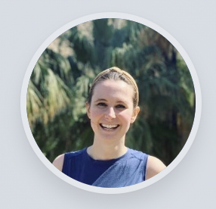







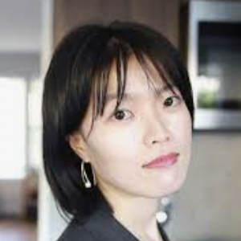
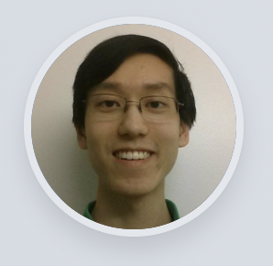

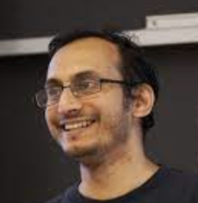

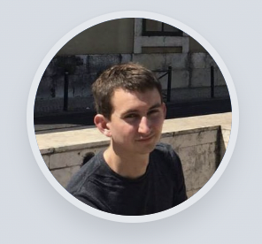





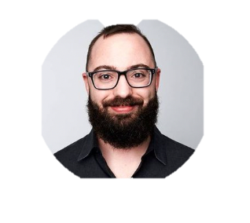




FAIR Diplomacy Team
Anton Bakhtin Noam Brown Emily Dinan Colin Flaherty Jonathan Gray Hengyuan Hu Athul Paul Jacob
Adithya
Renduchintala
Adam Lerer Mike Lewis Alexander Miller Weiyan Shi David Wu Hugh Zhang
Gabriele Farina Daniel Fried Andrew Goff Mojtaba Komeili Minae Kwon Karthik Konath Sasha Mitts
Stephen Roller Dirk Rowe Joe Spisak Alex Wei Markus Zijlstra
Notes:
This is joint work with a really large team of experts across a number of domains, including NLP, reinforcement learning, game theory, Diplomacy experts, and a number of cross-functional partners. It was really a privilege for me to have gotten to work with such an amazing team over the last 3 years on this challenge..

Slide 22

Recap
Sound self play will compute a minimax equilibrium in any two-player zero-sum given sufficient memory and compute
Outside two-player zero-sum games, self play isn’t enough
Self-play with KL regularization toward a human imitation policy (i.e., piKL) works well in general-sum games!
See our papers for details:
Mastering the Game of No-Press Diplomacy via Human-Regularized Reinforcement Learning and Planning. Bakhtin et al. ICLR 2023.
Human-Level Performance in the Game of Diplomacy by Combining Language Models with Strategic Reasoning. FAIR et al. Science 2023.
Code and models (along with those of our work in full-press): Diplomacy with dialogue) available at:
https://github.com/facebookresearch/diplomacy_cicero
Notes:
In conclusion, we hope our work is a step forward in learning strong human-compatible policies through RL. See our paper for details, and you can also find our code open sourced online along with our other recent work in the full natural language version of Diplomacy).
Thanks!

